Slide 1
Overcoming the educational constraints of IPM implementation with interdisciplinary practitioners:
Doctors of Plant Health/Medicine
Gary L. Hein
University of Nebraska – Lincoln

Slide 2
Increasing Challenges Facing Today’s Agriculture
Increasing number, costs of inputs
Volatile commodity prices
Managing water resources / competition
Pesticide, fertilizer stewardship
Bioenergy / competition for land
Food safety (pesticides, other contamination)
Changing climate
Invasive species / crop biosecurity
Enhanced sustainability

Slide 3
Core Competencies for IPM Practitioners
What are the core competencies necessary for IPM practitioners in order to increase the sustainability of agricultural systems?

Slide 4
Levels of
Integrated
Management
IPM
‘integration’
IPM Tactics
Cultural
HPR
Biol. Control
Chemical
Sampling/Thresh.
Resist. Man.
Pest / Host Biology & Ecology

Slide 5
Levels of
Integrated
Management
Integrating IPM
Multiple Pests
IPM
‘integration’
IPM Tactics
Cultural
HPR
Biol. Control
Chemical
Sampling/Thresh.
Resist. Man.
Pest / Host Biology & Ecology

Slide 6
Levels of
Integrated
Management
Integrating IPM
Multiple Pests
IPM
‘integration’
IPM Tactics
Cultural
HPR
Biol. Control
Chemical
Sampling/Thresh.
Resist. Man.
Pest / Host Biology & Ecology
System Ecology, Economics, Sociology

Slide 7
Levels of
Integrated
Management
Comprehensive
System Management
Integrating IPM
Multiple Pests
IPM
‘integration’
IPM Tactics
Cultural
HPR
Biol. Control
Chemical
Sampling/Thresh.
Resist. Man.
Pest / Host Biology & Ecology
System Ecology, Economics, Sociology

Slide 8
Core Competencies for IPM Practitioners
Comprehensive education across disciplines

Slide 9
Core Competencies for IPM Practitioners
Comprehensive education across disciplines
Need for systems thinkers with ability to synthesize and integrate

Slide 10
Core Competencies for IPM Practitioners
Comprehensive education across disciplines
Need for systems thinkers with ability to synthesize and integrate
Have practical understanding and experience with the system where they work

Slide 11
Core Competencies for IPM Practitioners
Comprehensive education across disciplines
Need for systems thinkers with ability to synthesize and integrate
Have practical understanding and experience with the system where they work
Ability and experience in critical thinking and problem solving

Slide 12
Core Competencies for IPM Practitioners
Comprehensive education across disciplines
Need for systems thinkers with ability to synthesize and integrate
Have practical understanding and experience with the system where they work
Ability and experience in critical thinking and problem solving
Possess superior communication skills - both written and verbal

Slide 13
Core Competencies for IPM Practitioners
How well do traditional graduate programs prepare these types of professionals?
Predominately single discipline
Research funding / productivity pressures often drive narrower focus
Predominately research based; limited opportunity/time for practical experiences

Slide 14
Core Competencies for IPM Practitioners
“While master’s programs are often geared toward the needs of the workplace, this is not necessarily true at the doctoral level. Clear career options are often lacking.”
The Path Forward: The future of graduate education in the United States, Council of Graduate Schools, 2010.

Slide 15
DPM, DPH programs comparable
Doctor of Plant Health Mission
to educate and train plant practitioners with comprehensive expertise and experience across the various disciplines that impact plant health and plant management
diagnose and solve plant health problems
develop/implement more sustainable integrated plant and pest management systems

Slide 16
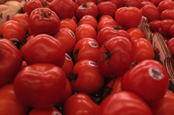
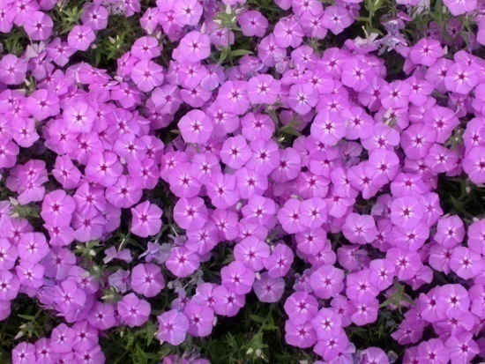
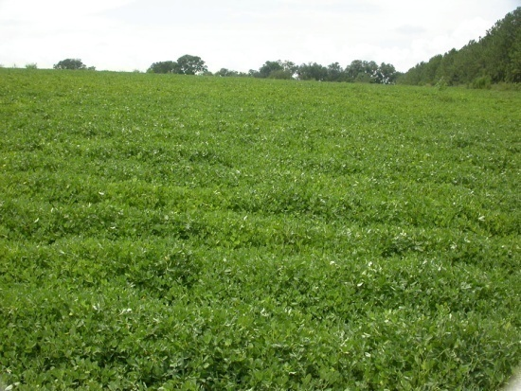
What is the difference between
the DPM/DPH and Ph.D.?
DPM/DPH are broadly focused, course- and internship-based
Applied research included but does not require a dissertation
Concept comparable to the professional doctoral, practitioner degrees in human (MD) and animal medicine (DVM)

Slide 17
Program features
Interdisciplinary core

Slide 18
Curriculum (120 credits total)
‘Core’ (ca. 74 credits)
Plant Pathology
Entomology
Plant Science
Soil Science
Weed Science
Other
Quantitative tools
Policy & Law

Slide 19
Program features
Interdisciplinary core
Electives (16 credits)
Flexibility to meet career goals
Develop specialty area of training

Slide 20
Potential specialty areas
Production agriculture
Landscape horticulture
Resource management (range, forestry)
Specialty production (organics, greenhouse, etc.)
Food safety
Regulatory
Plant biosecurity
Teaching / extension

Slide 21
Program features
Interdisciplinary core
Electives
Research experience
UNL: Research Practicum
UF: Clinical Trials

Slide 22
Program features
Interdisciplinary core
Electives
Research experience
Comprehensive diagnostic training
Experiential training (internships)
Multidisciplinary

Slide 23
Program features
Interdisciplinary core
Electives
Research experience
Comprehensive diagnostic training
Primary Internships (16 credits)
Focus – integration and application
Flexibility to meet students career needs

Slide 24
Program features
Interdisciplinary core
Electives
Research experience
Comprehensive diagnostic training
Primary Internships
Skills development
Leadership, communication, ethics

Slide 25
Students entering program
B.S., B.A. or M.S. in biological/plant related field
Plant science background
Time for completion
4 years after bachelors
3 years after master’s
Depends on course load / scheduling of internships

Slide 26
Levels of
Integrated
Management
Comprehensive
System Management
Integrating IPM
Multiple Pests
IPM
‘integration’
IPM Tactics
Cultural
HPR
Biol. Control
Chemical
Sampling/Thresh.
Resist. Man.
Pest / Host Biology & Ecology
System Ecology, Economics, Sociology

Slide 27
Three Progressive Levels of IPM Education
(target audiences)
Univ./Industry Researchers
Extension specialists
Regulatory personnel
Graduate DPM/DPH students
Consultants/advisors
Comprehensive
Farmers
Farm managers
Agribusiness personnel
Undergraduate students
Management
Competent
Ag support industry
Ag lenders
Landlords
Baseline
Understanding

Slide 28
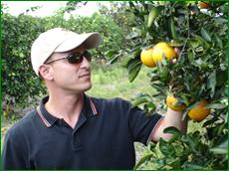
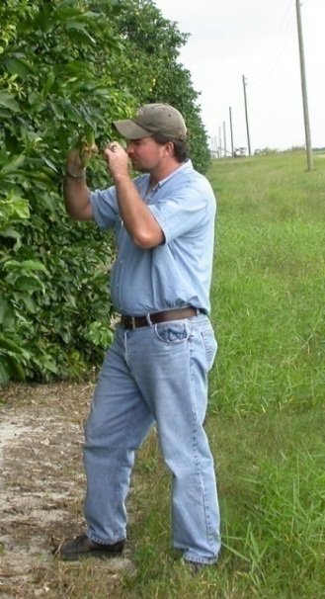
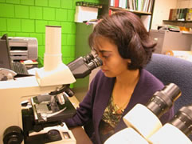
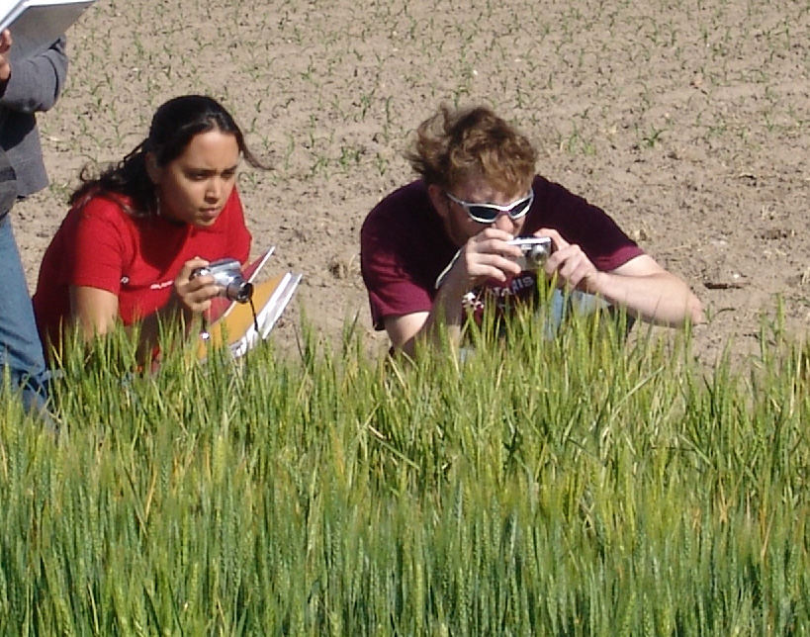
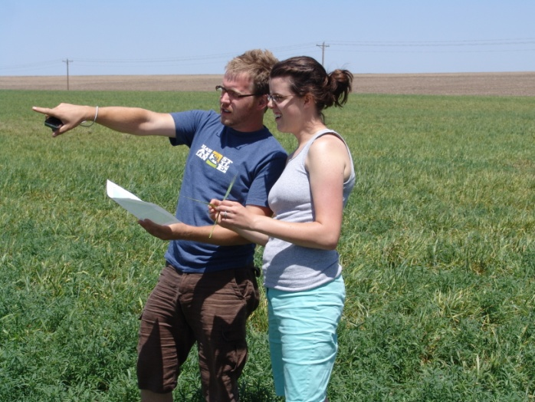
Questions / Discussion

